Slide 1
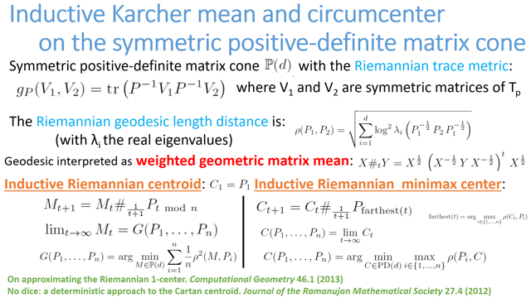

Slide 2
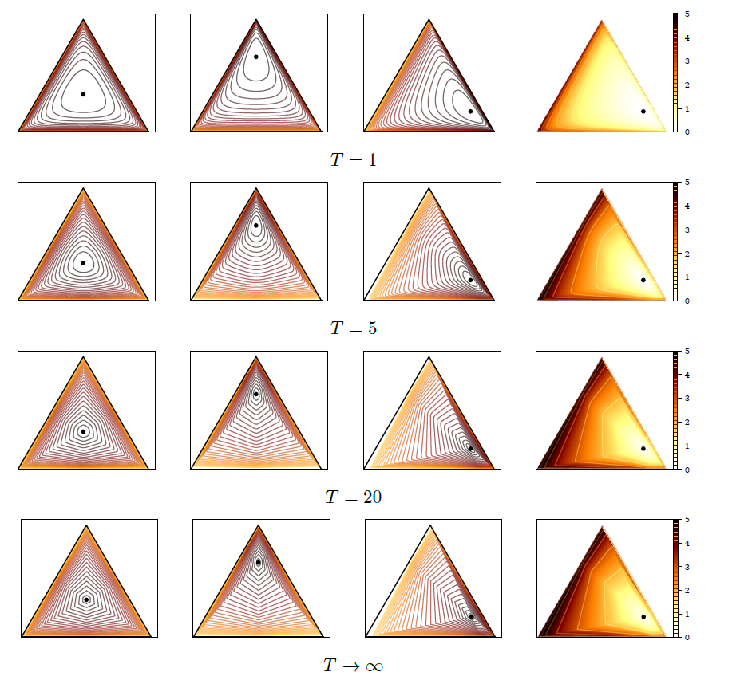
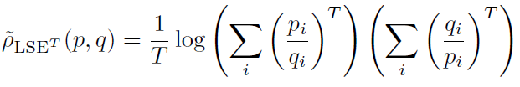
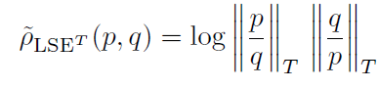
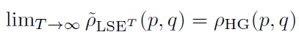
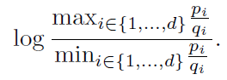
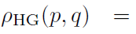
Differentiable approximations of Hilbert simplex distance
Differentiable approximations
h
Differentiable approximations of ρ_{HG} :
converges to Hilbert simplex distance:
Non-differentiable Hilbert simplex distance:

Slide 3
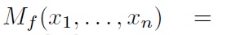
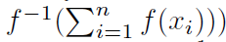
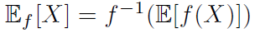
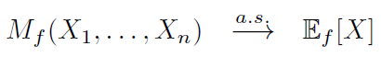
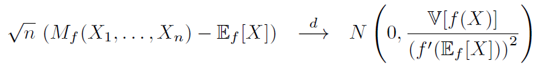
A generalization of the law of large numbers (LLN) and the central limit theorem (CLT)
Quasi-arithmetic means for a strictly monotone and smooth function f(u):
Quasi-arithmetic expected value of a random variable X:
Law of large numbers for an iid random vector with variance V[X]<∞:
Central limit theorem:
Miguel De Carvalho. Mean, what do you mean? The American Statistician, 70(3):270-274, 2016.

Slide 4



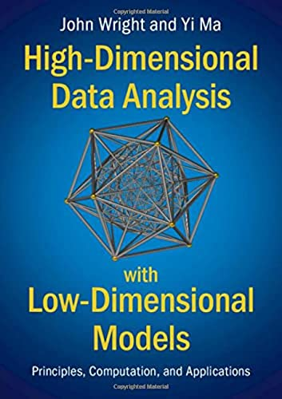

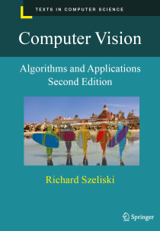
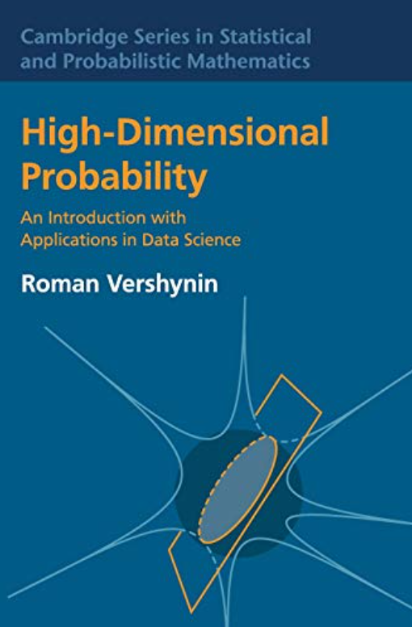
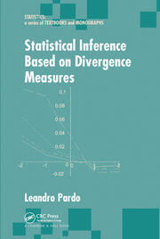
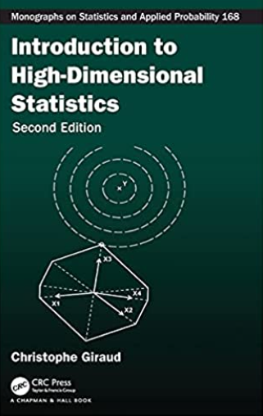

Slide 5
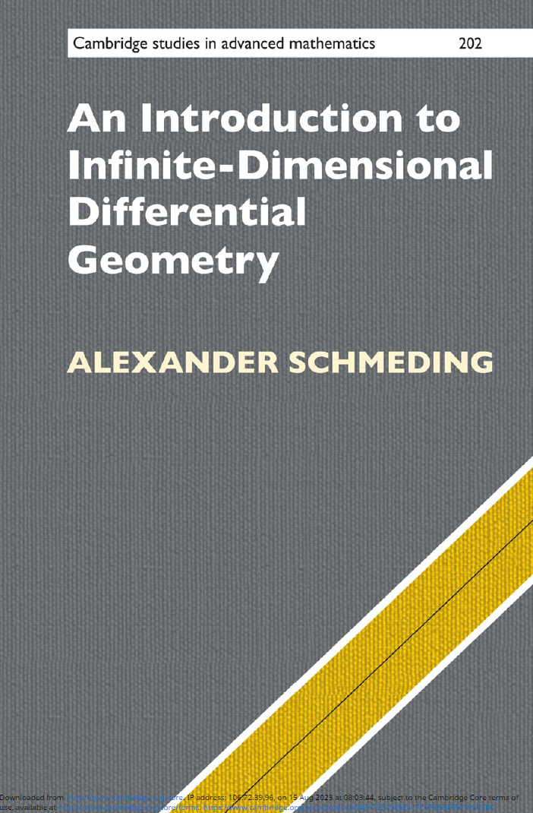
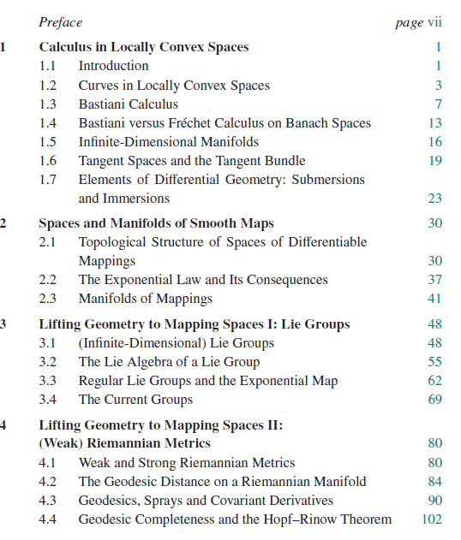
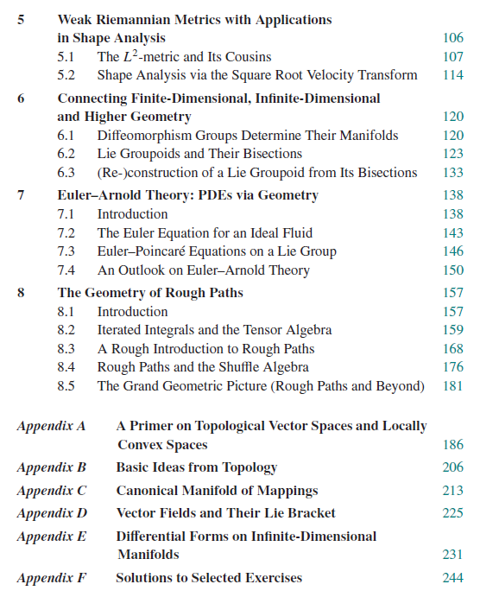

Slide 6
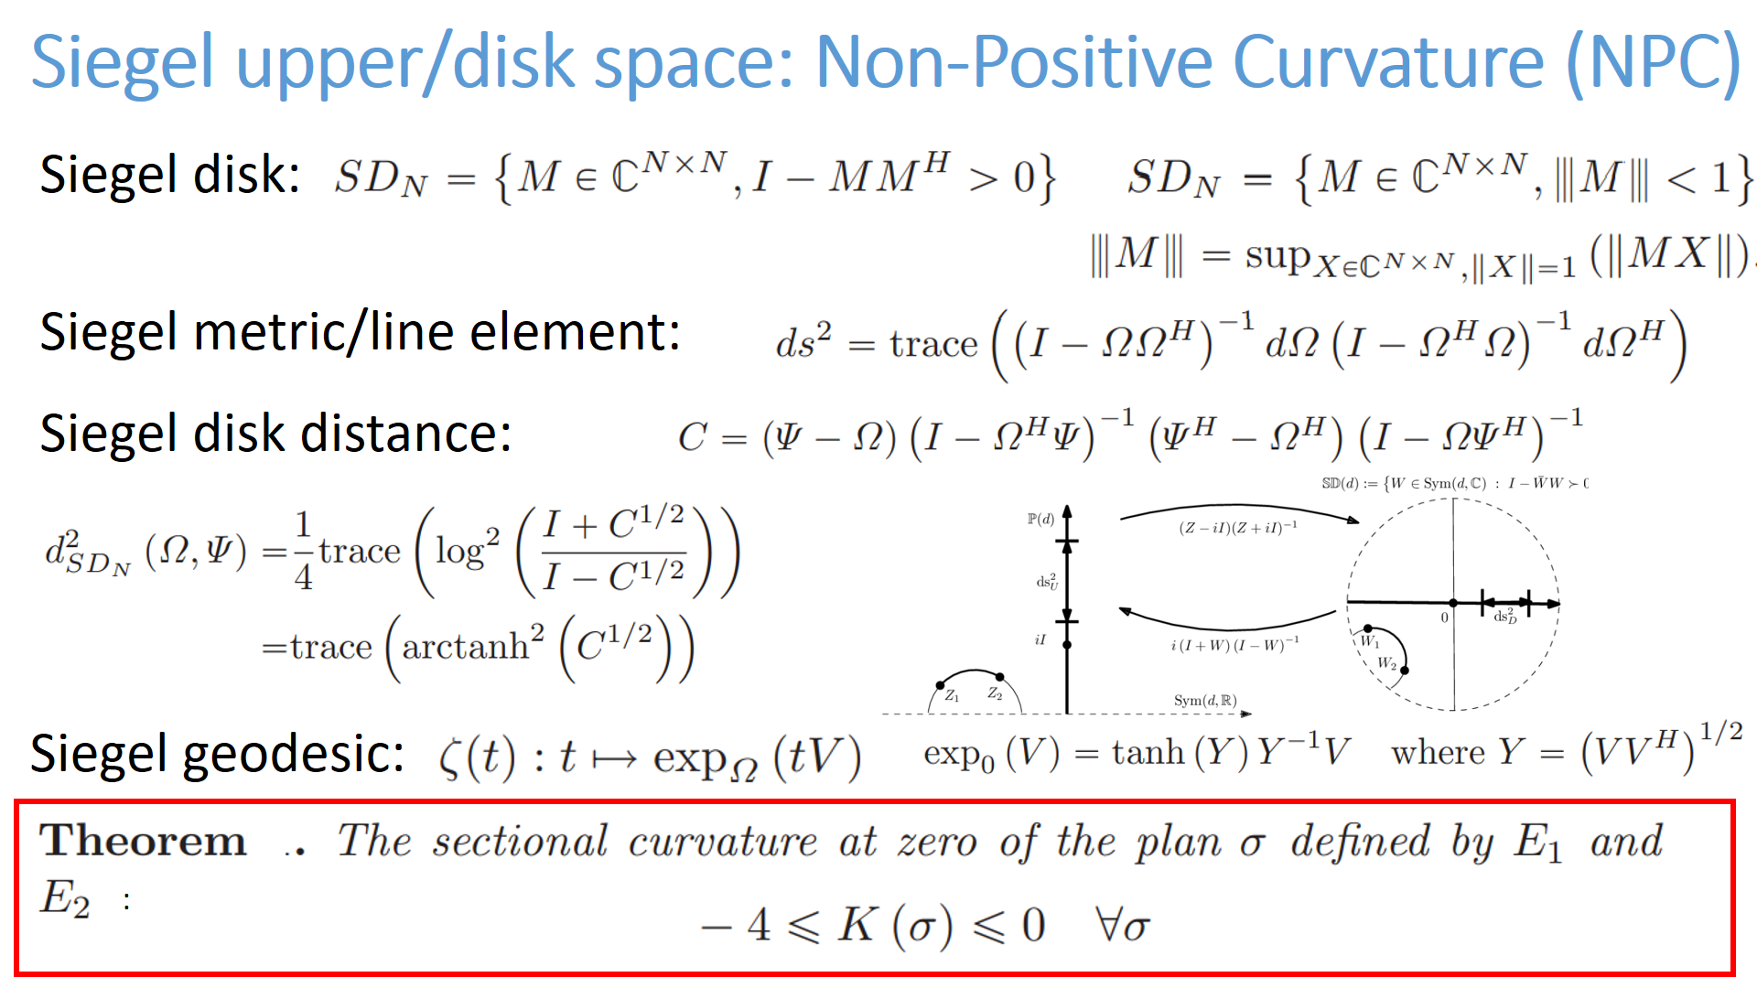

Slide 7
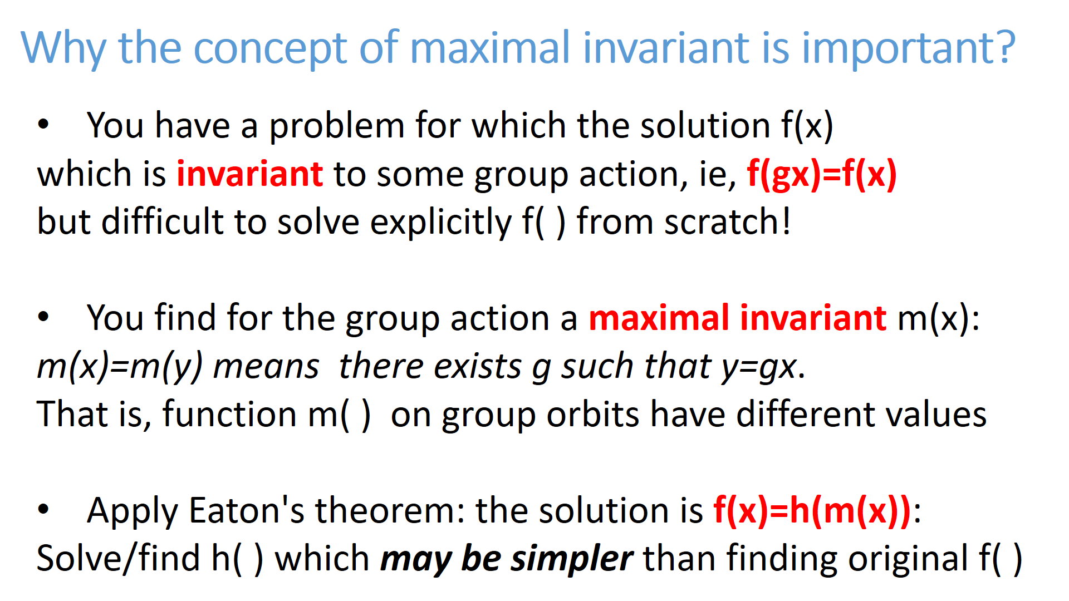
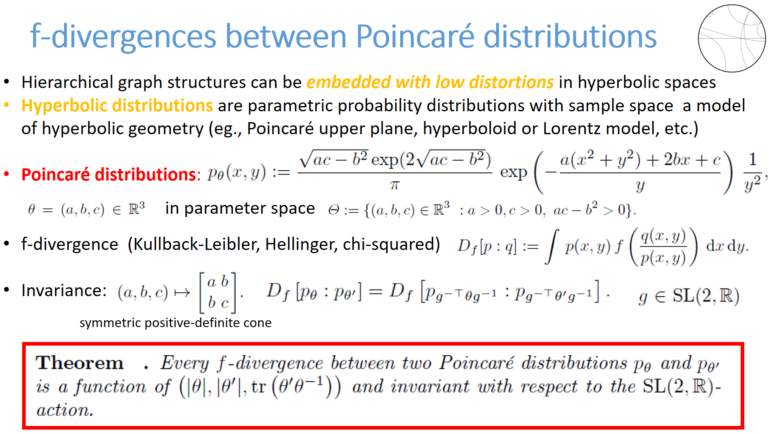

Slide 9
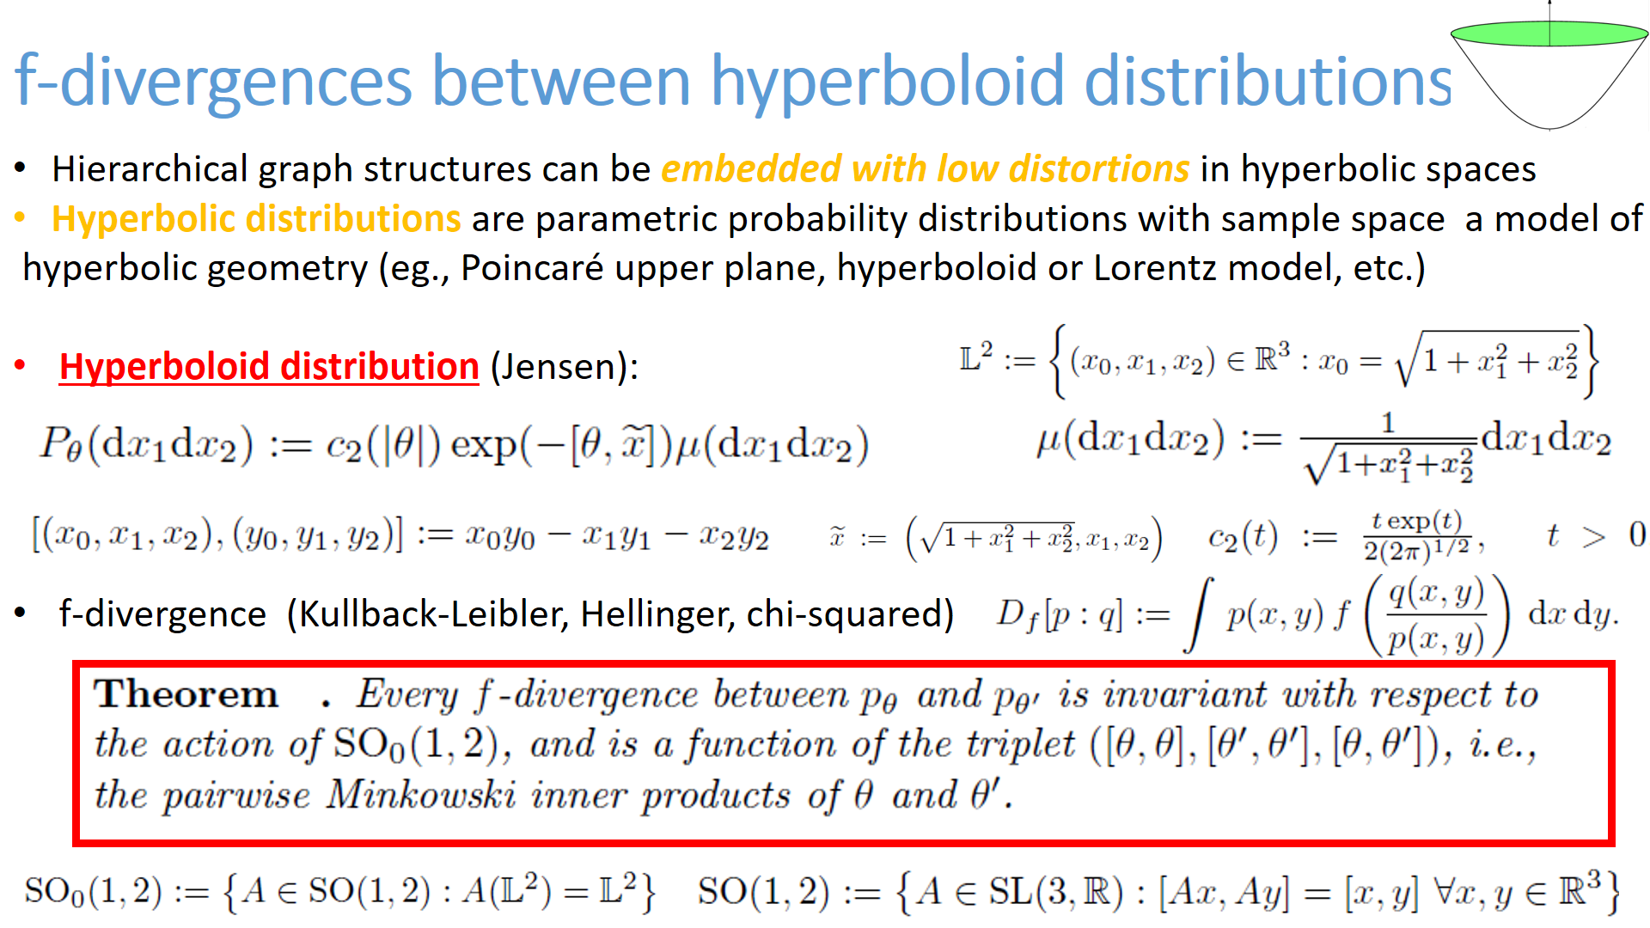

Slide 10
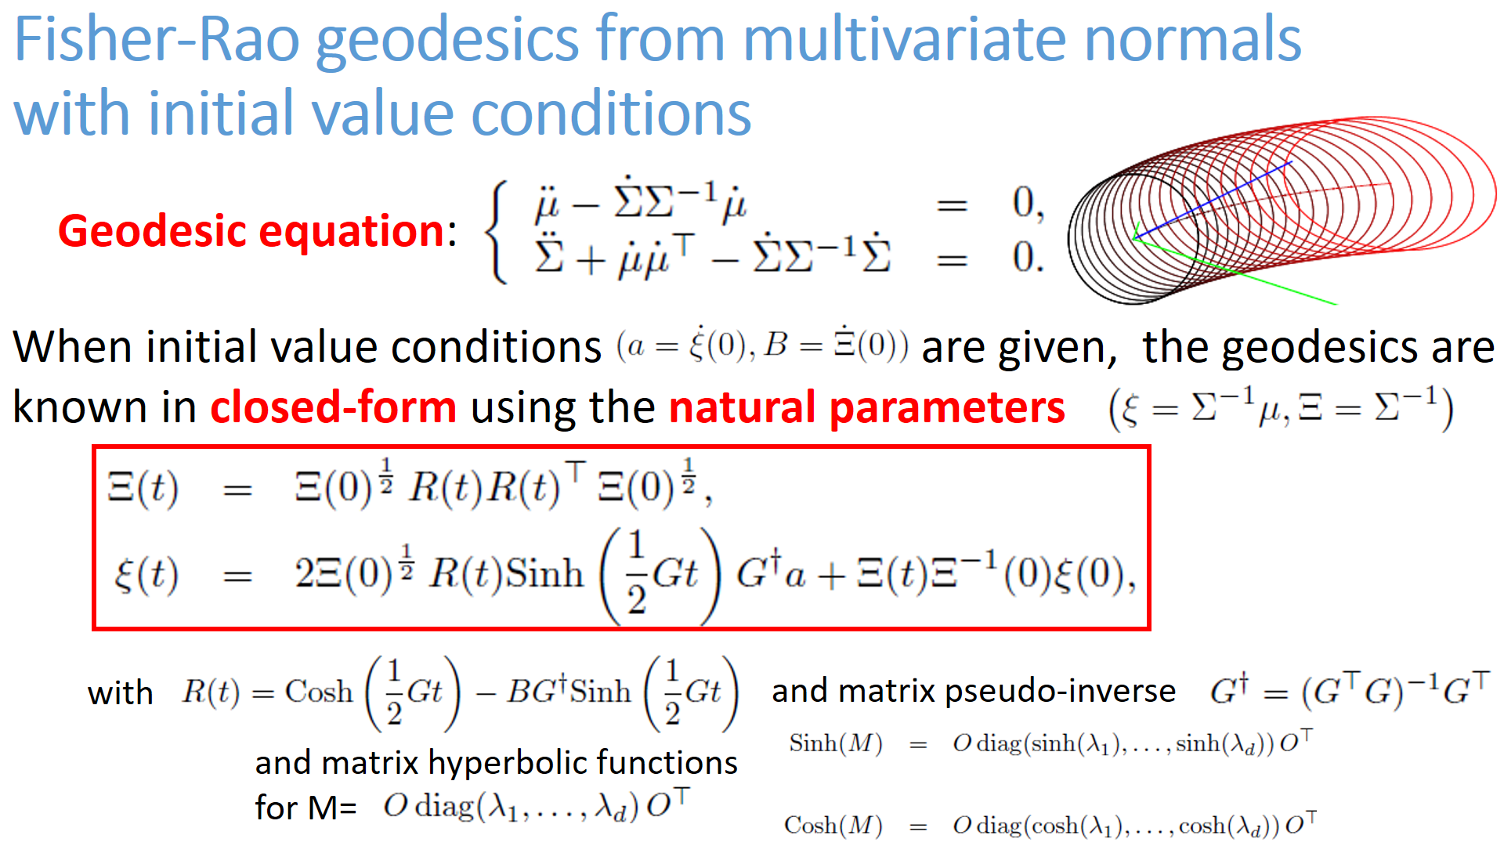

Slide 11
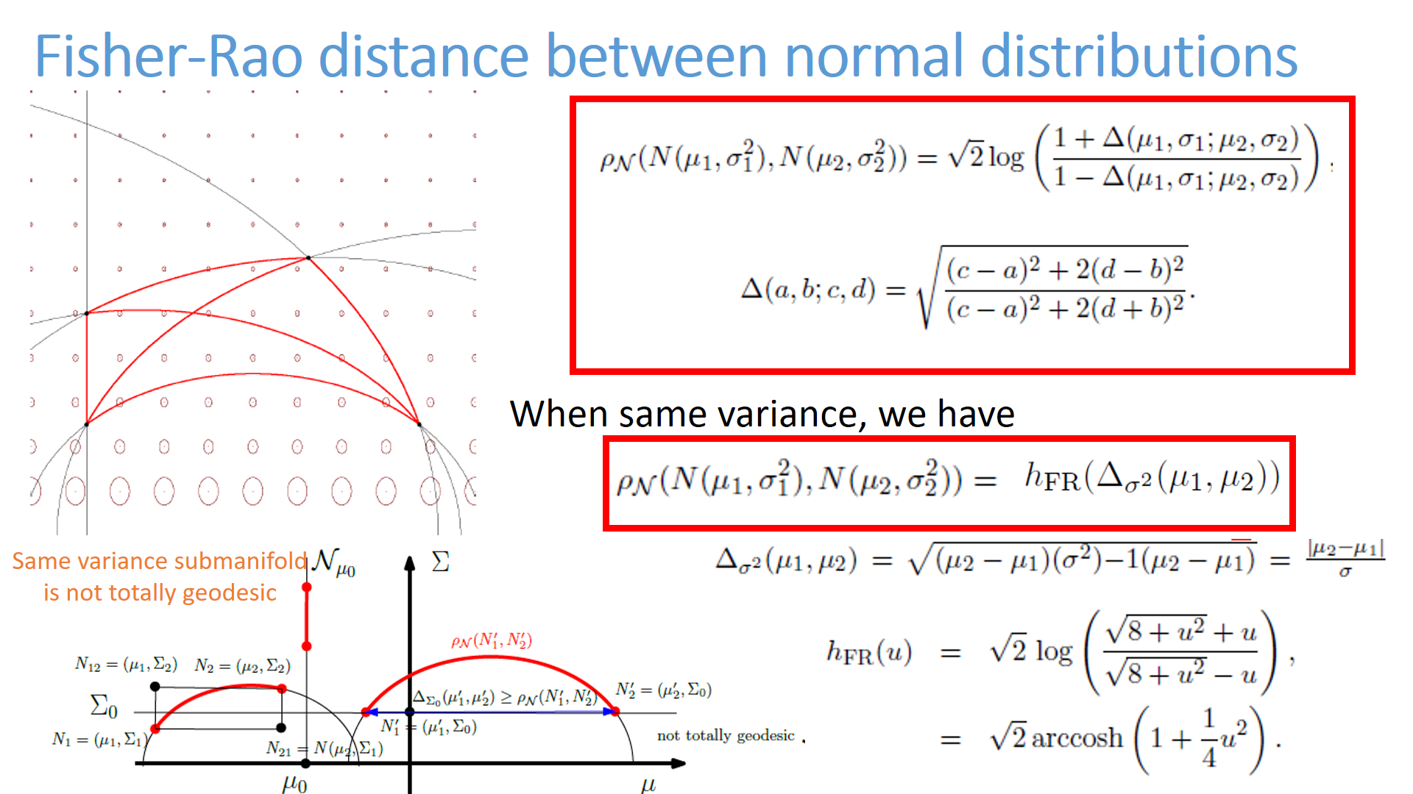

Slide 12
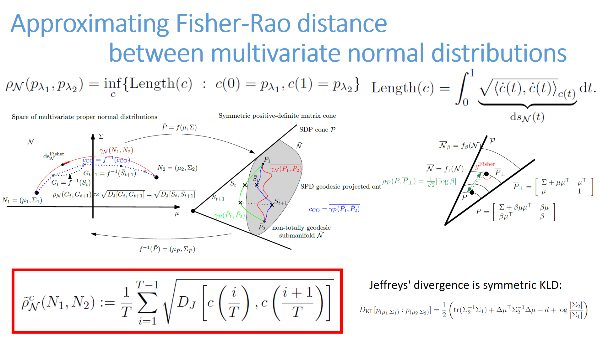

Slide 13
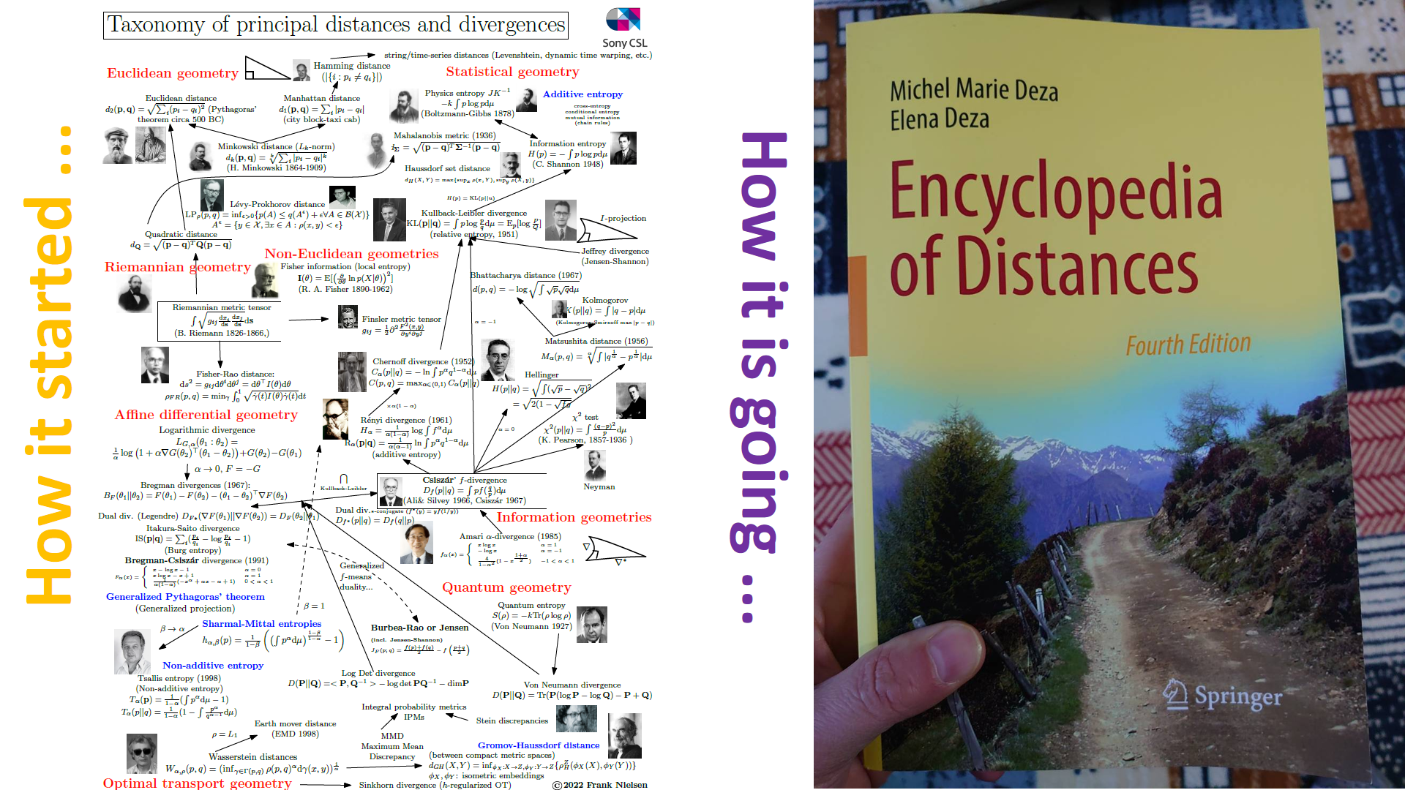

Slide 14
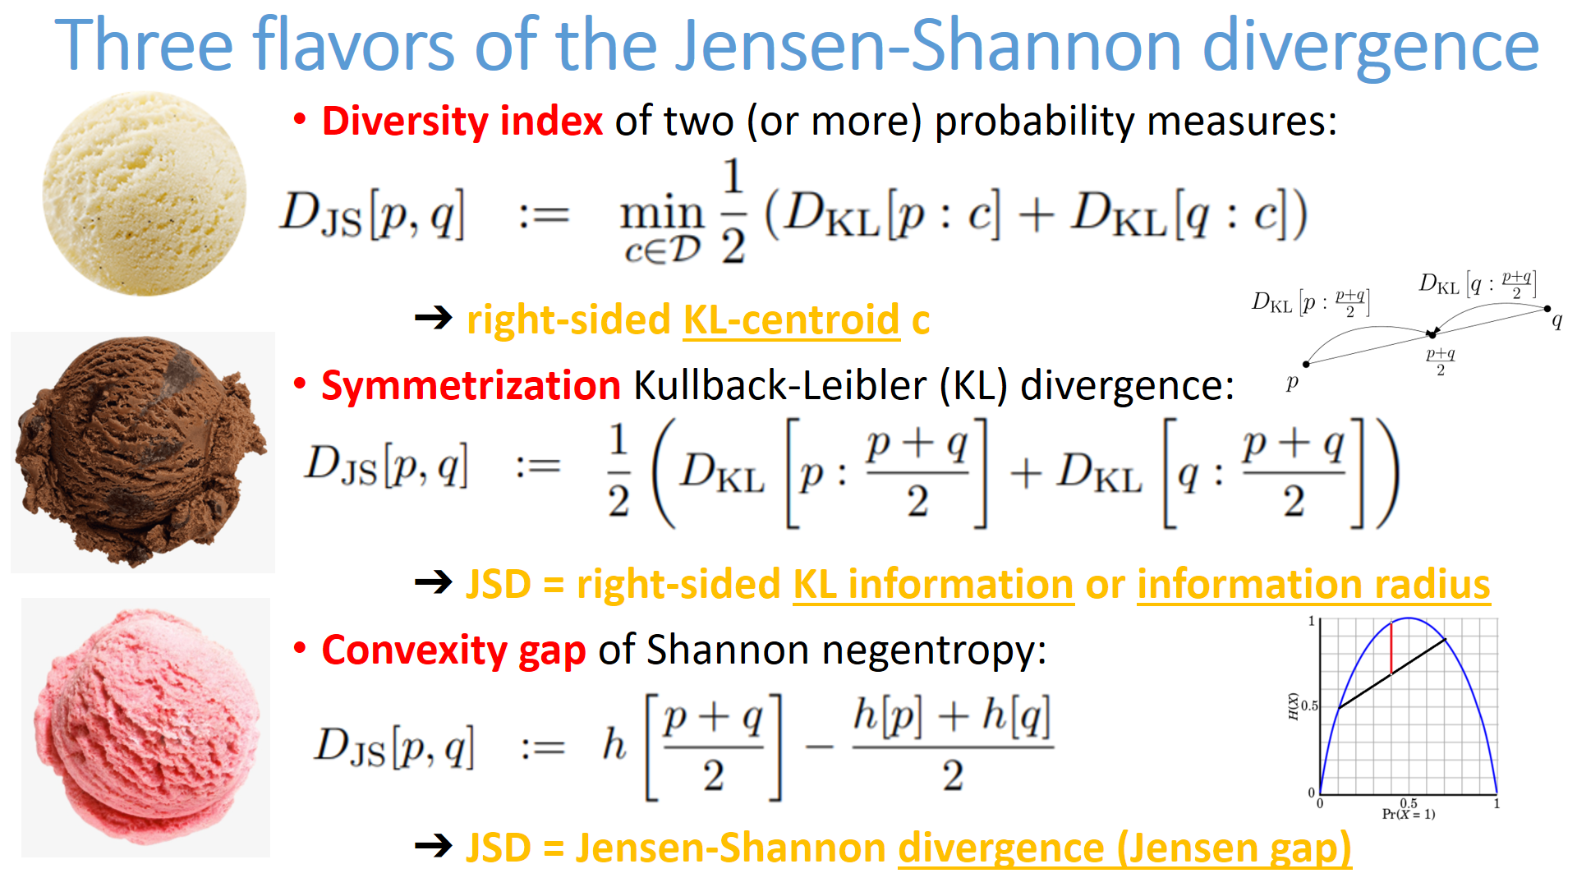

Slide 15
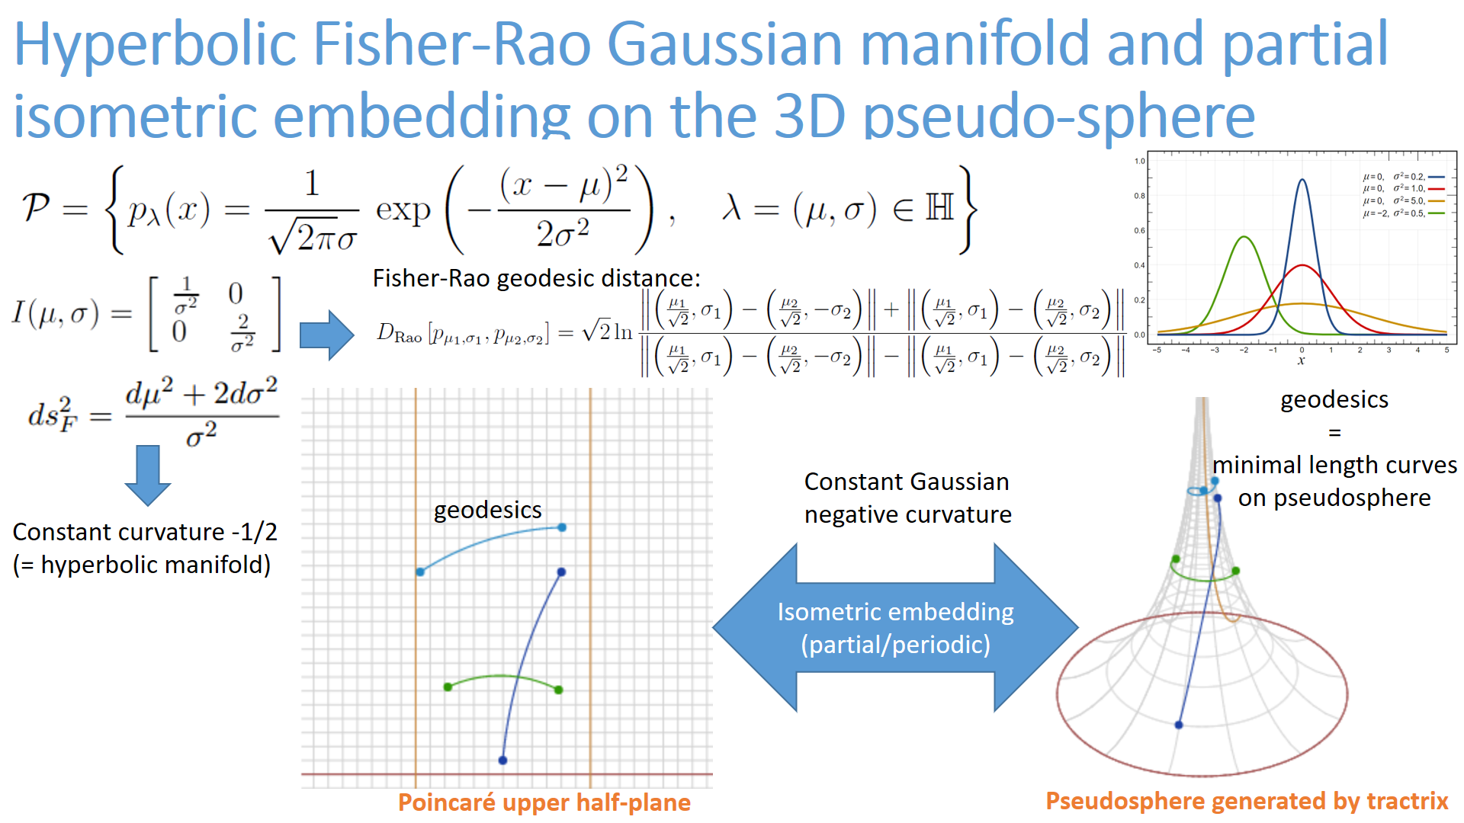

Slide 16
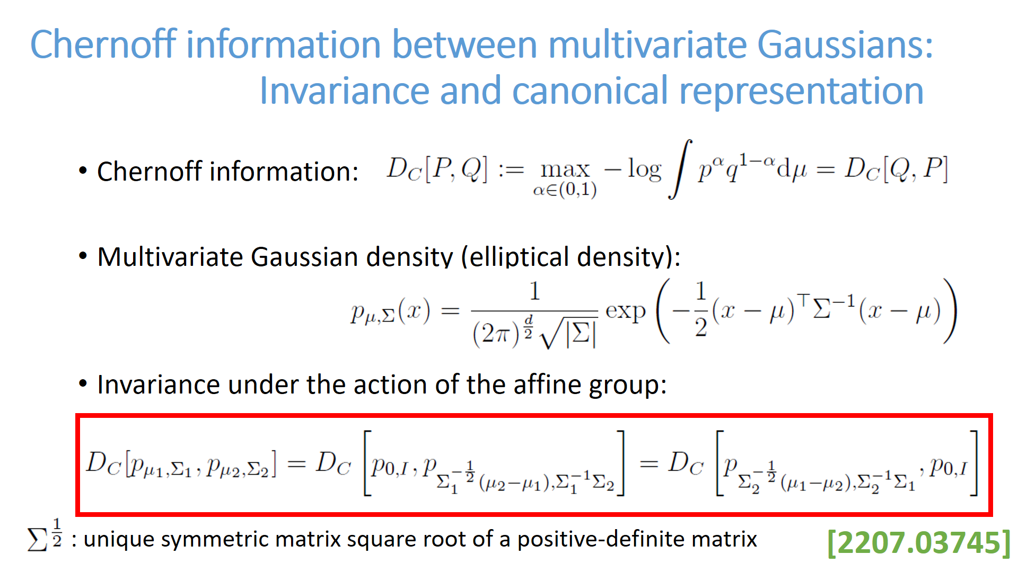

Slide 17



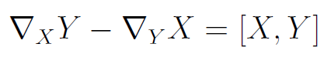

Fundamental theorem of Riemannian geometry
There exists a unique metric torsion-free connection ∇ induced
by the metric tensor g, called the Levi-Civita connection
3-covariant tensor ∇g acting on vector fields X, Y, and Z:
metric compatibility of ∇:
metric tensor g is preserved by parallel transport of ∇
Torsion-free ∇:
(Lie bracket)
Koszul formula defining ∇:
Notes:
Fundamental theorem of Riemannian geometry: There exists a unique metric torsion-free connection ∇ induced
by the metric tensor g, called the Levi-Civita connection given by the Koszul formula
$3$-covariant tensor acting on vector fields
$$
(\nabla g)(X,Y,Z) = X g(Y,Z)-g(\nabla_X Y,Z)-g(\nabla_X Z,Y)
$$
$$
\nabla g=0 \Longrightarrow X g(Y,Z) = g(\nabla_X Y,Z)+g(\nabla_X Z,Y)
$$
$$
\nabla_X Y-\nabla_Y X =[X,Y]
$$

